Slide 1
Air pump failure detection
Solution to help detect failure of air pumps in machines

Slide 2
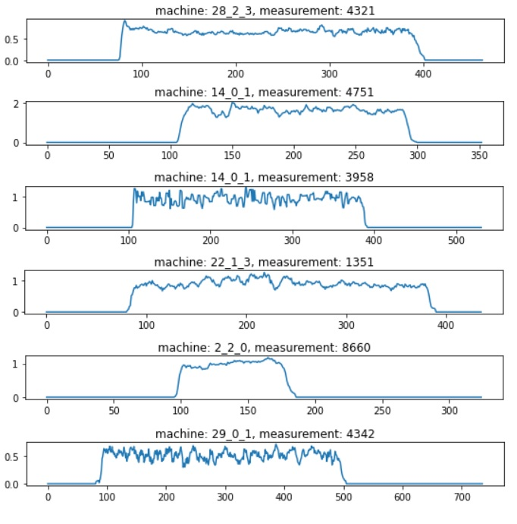
What is air pump cycle?
Devices that we work with contains air pumps. When device is running, air pumps are running as well, providing ideally constant pressure during whole running cycle.
We measure pressure through the running cycles, and record how pressure is changing over time.
Look at charts on right side of this slide. They represent pressure over time during six different machine cycles.

Slide 3
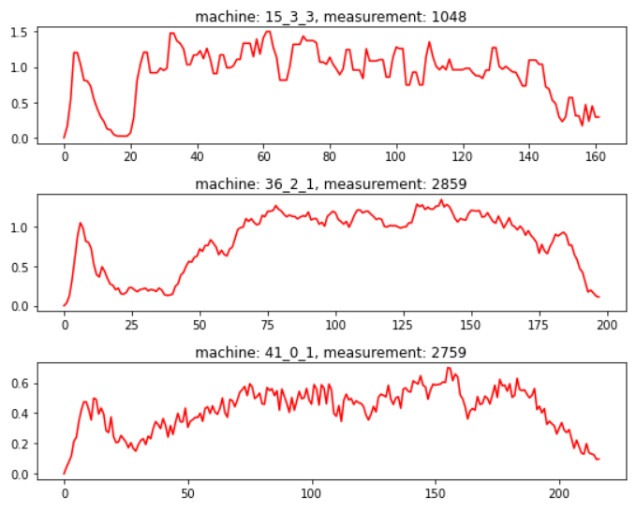
Failure cycles
Sometimes, there is air pump failure during the machine cycle.
Usually, it looks like that pressure temporary drops.
On the right side you can see few examples of air pump failures.
Note how pressure drops and then raises again, although it’s not always so obvious, for example last chart is not so clear as the first one.

Slide 4
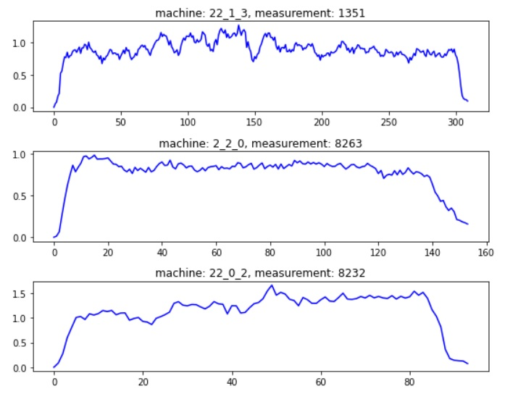
Comparison of failing and correct cycles
Correct air pump cycles
Failure air pump cycles

Slide 5
How do we recognize failure?
As mentioned before, failure can be quite easily seen in chart
We have hundreds of machines and thousands of cycles
If we were able to automatically suggest failure detection, we could save a lot of human labor time

Slide 6
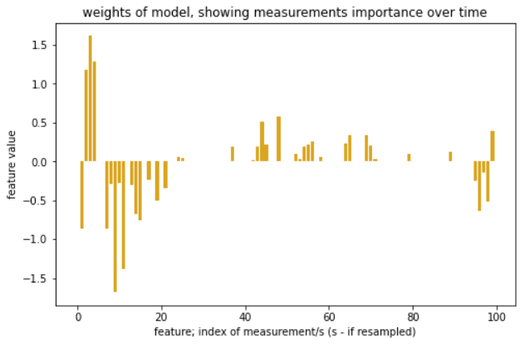
What was the approach?
Pressure is high again
We developed a model, that finds the general pattern of pump failure.
Chart on right side represents general pattern that model found for failure cycle.
Orange bars shows expected relative pressure at given time. The more is pressure cycle like this pattern, the more likely there was failure.
Pressure is high
Pressure is low

Slide 7
How good the model is?
Nearly 90% correct evaluations
More than 60% of failures found
More than 60% of detections were real failures
The model can help to identify cases of pump failures.
Although it’s not perfect, it can help to save time and energy to human worker, by analyzing cycles, and providing failure detection suggestions.
Numbers on right side shows how well model performed on more than 3k analyzed measurements from 94 machines, where failure occurred in 16% of measurements
Note that none of these cycles were provided to model during training process, nor any other cycles from these machines.

